Slide 1
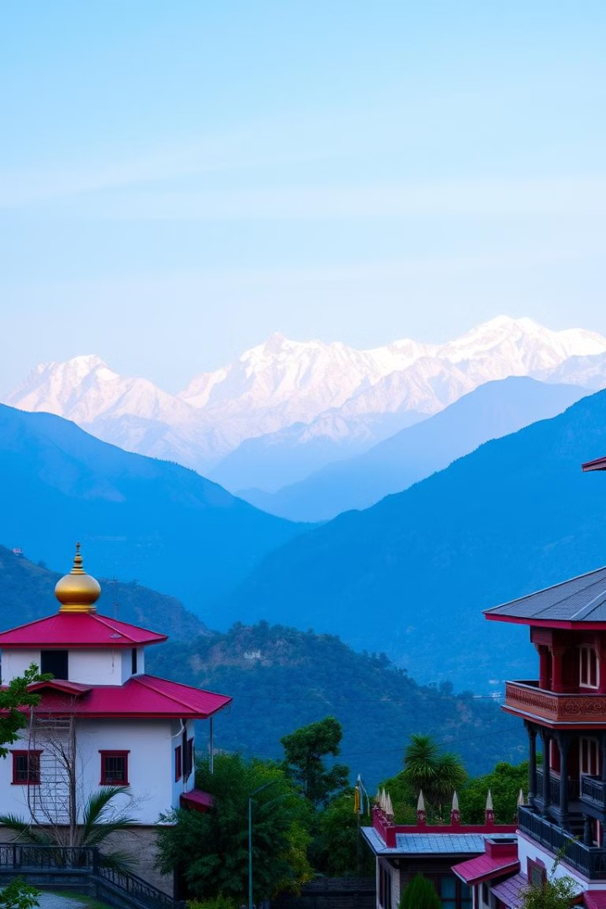

Unity in Diversity: India
India is a land of immense diversity, a tapestry woven from vibrant threads of religion, geography, language, climate, art, and folklore. This presentation explores how India celebrates diversity, achieves unity, and inspires the world.
by bhawna k

Slide 2
Religious Diversity in India
Hinduism
Islam
Other Religions
India is the birthplace of Hinduism, one of the world's oldest and most diverse religions. Hinduism is characterized by its vast array of deities, rituals, and philosophies.
Islam arrived in India centuries ago, and its presence is deeply woven into the country's cultural fabric. Islam is a monotheistic religion that emphasizes faith, charity, and justice.
India is also home to a multitude of other religions, including Sikhism, Buddhism, Jainism, and Christianity. Each of these faiths has its own unique traditions and practices.

Slide 3
Geographical Diversity in India
Himalayas
Deserts
Coastal Regions
The Himalayas are a mountain range in Asia and are home to the highest peaks in the world. The Himalayas are a natural wonder and are important to the environment and economy of India.
India's deserts are home to a unique ecosystem and are a testament to the country's diverse geography. The deserts are home to many different species of plants and animals that have adapted to the harsh environment.
India's coastlines are a source of beauty and economic activity. They are home to a variety of ecosystems, including beaches, mangroves, and coral reefs. These ecosystems provide habitat for a variety of species and are important to the country's tourism industry.

Slide 4
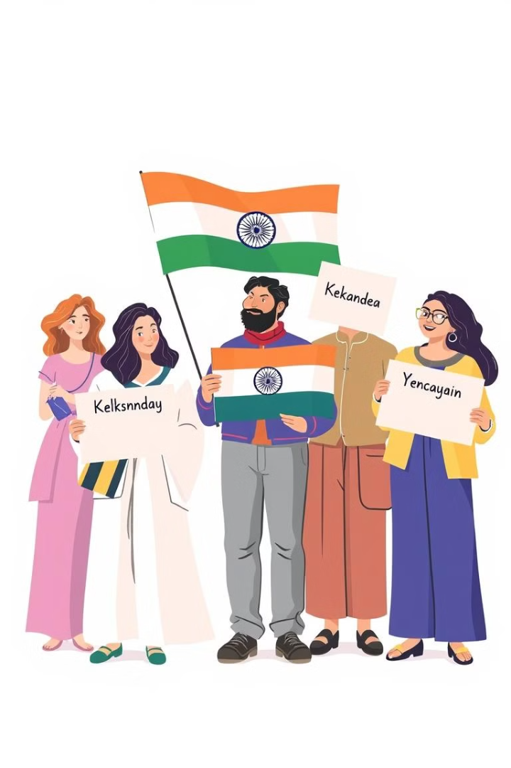
Linguistic Diversity in India
Indo-Aryan
Dravidian
Hindi, Bengali, Marathi, Gujarati, Punjabi, and Urdu are some of the major languages spoken in India.
Tamil, Telugu, Kannada, and Malayalam are some of the major languages spoken in India.
Other Languages
India also has many other languages, including tribal languages, English, and others. This diversity is a testament to India's rich and varied cultural heritage.

Slide 5
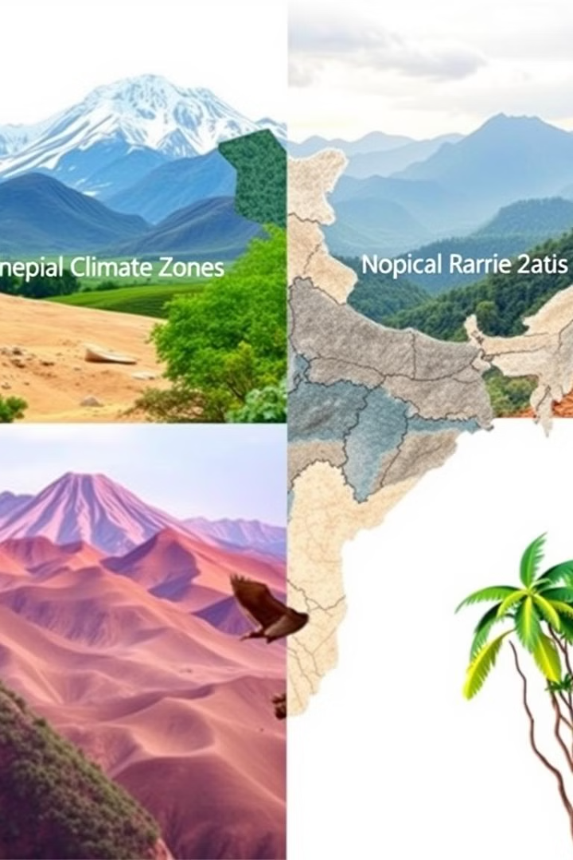
Climate Diversity
1
From the frigid peaks of the Himalayas to the scorching deserts of Rajasthan, India experiences a wide range of climates.
2
The country's diverse climate is a product of its geographical location, elevation, and monsoon winds.
3
This diversity is reflected in the country's flora and fauna, which have adapted to the unique conditions of each climate zone.

Slide 6
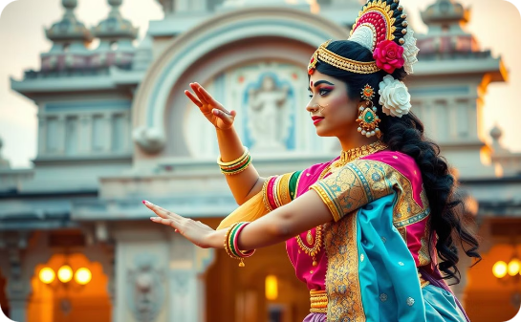
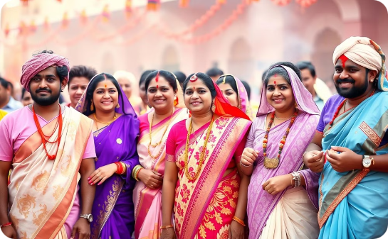

Art and Folk Diversity
Dance
Festivals
Music
India has a rich and diverse dance tradition, with many different forms of dance practiced throughout the country.
India is a land of festivals, and each festival is celebrated with its own unique traditions and customs.
Indian music is characterized by its complex rhythms, melodies, and ragas, which are scales that evoke different emotions.

Slide 7
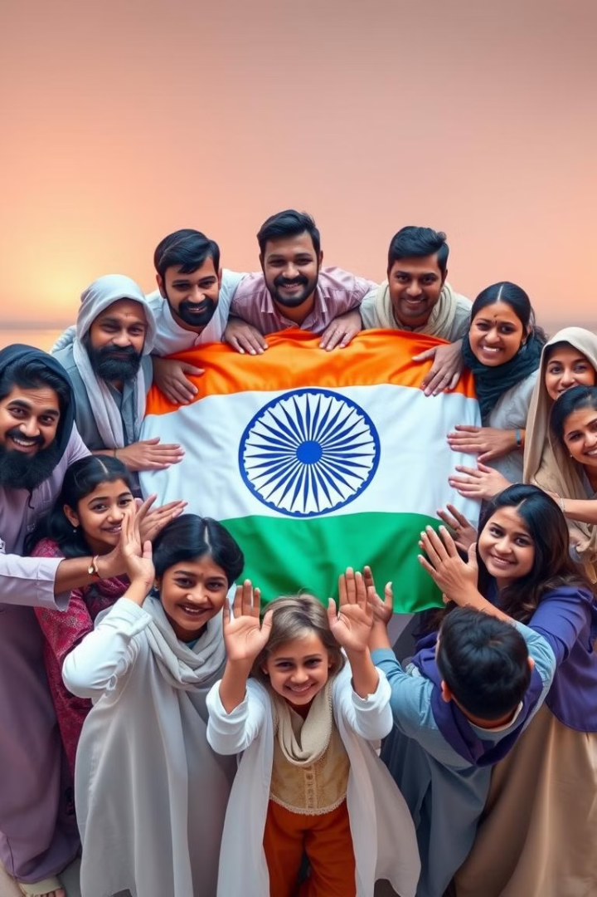
Conclusion: Celebrating Diversity, Achieving Unity
India's diversity is a source of strength and unity. Through its rich cultural heritage, India has developed a unique ability to celebrate differences and come together as one. This ability is an inspiration to the world.

